Slide 1

Image Steganography using CNN
Team.No - N23
Guided by:- Dr.G.S.Hanchinamani
Yajas menon (01fe20bcs048)
Akash Kumar (01fe20bcs300)
Apoorv Bagal (01fe20bcs065)
Abhishek kumar (01fe20bcs059)

Slide 2
Problem Statement
Hiding secret information in an image using convolutional neural network .

Slide 3
Introduction
Steganography is the practice of concealing messages or information within other non-secret text or data. The goal of steganography is to hide the existence of the message from unauthorized third parties.
With new technology, it has become easier to do and harder to find, making it a good way for people to keep important information safe from others who want to see it.

Slide 4
Motivation
The availability of numerous readily available tools has made the possibility of malicious threats, eavesdropping, and other subversive activities.
These tools are capable of exploiting the privacy, data integrity, and security of the data being transmitted
Steganography hides information in an image making it difficult for unauthorized individuals to access it
Traditional Steganography have limited capacity to hide information. The larger the size of the message to be hidden, the more noticeable the changes
Traditional steganography methods are susceptible to detection by steganalysis techniques.

Slide 5
Objectives
Our objective is to :-
To hide data or information within an image in a way that it is not easily noticeable or detectable by unauthorized persons.
To protect the confidentiality of the hidden data by making it difficult for unauthorized individuals to access or extract the information.
To extract hidden information from a given cover image.

Slide 6
Literature Survey

Slide 7
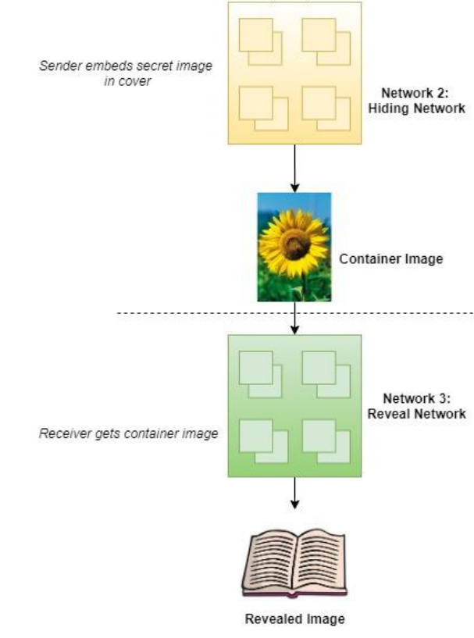
Steganography Techniques Using Deep Neural Networks
Publish Year:2020
Authors:Vijay Kumar , Saloni Laddha, Aniket, Nitin Dogra
Methodology
This paper deals with 3 methods: LSB encoding,masking and filtering and deep neural network.
LSB:The secret message is converted into the bits and then those bits are placed at the least significant bit (also known as, the 8th bit) of all or some random pixels of the cover image to get the maximum capacity and performance of information hiding.
Masking and Filtering:It is mainly used to insert watermarks on original images so that no one can illegally copy or use that content without credits
Suggests a two network structure otherwise: Hiding-network and Reveal-network
Hiding network:To embed the secret image in a cover image
Reveal Network:Extraction of secret information from cover image
Results
The container image looks similar to the cover image and the size of the image is not changed to susceptible levels. There is a deviation between the revealed secret image and the original secret image due to all the operations performed on it, but it is not noticeable to the naked eye.

Slide 8
.The adaptive steganography algorithm changes the assumption that steganographic information is independent of the carrier content and can adapt to the image content when embedding the secret message
Its purpose is to determine whether the image to be tested contains a confidential message, most steganalysis methods include feature extraction and classifier design
A rich steganographic detection feature is proposed from each submodel by building rich submodels for images, and then all the features are combined to form rich model features, which are usually of high dimensions,
Rich model features can extract steganographic features from multiple angles, which cause message embedding.
SVM is a traditional method in this paper gram matrix were used to reduce dimensionality
linear discriminant classifier based on random forest to solve the problem of high dimensionality of rich model features
secret messages and embedded locations are used when embedding secret message
JPEG image steganalysis combining rich models features and cnn
Publish year:2019
authors:Tao Zhang1, Hao Zhang2 , Ran Wang2 and Yunda Wu
Methodology
Results
Rich model features are often used to detect adaptive steganography algorithms with strong undetectability, two new adaptive steganographic algorithms are adopted in this study, J-UNIWARD and UED. Its efficiency reduced as move towards the forward compared to the the traditional method due to trained feature and high dimensions.

Slide 9
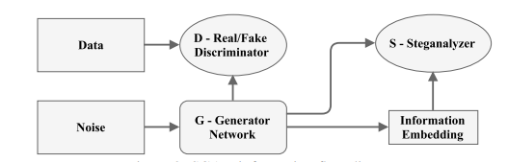
Steganographic Generative Adversarial Networks
Publish Year:2017
Authors:Denis Volkhonskiy , Ivan Nazarov, Evgeny Burnaev
Methodology
In this paper, a model for generating image-like containers based on Deep Convolutional Generative Adversarial Networks
Consists of generator network,decryption network and discriminator
Three models compete against each other in such a way that the generator produces the stego images and the discriminator decodes and recovers the secret message while the stegananlyzer eavesdrops on the generator produces the probability
Results
Experiment results demonstrate that the new model successfully deceives the steganography analyzer, and for this reason, can be used in steganographic applications.Using GAN for hiding data is much complex and difficult to implement with limited computing power which makes decreases its performance.

Slide 10
An Automatic cost learning framework for Image steganography
Publish Year:2021
Authors: Weixuan Tang , Bin Li, Mauro Barni, Jin Li, Jiwu Huang
Methodology
In this paper , they have proposed a new embedding cost learning framework called SPAR-RL(Steganography Pixel-wise Actions and Rewards with Reinforcement Learning).
In SPAR-RL, an agent utilizes a policy network which decomposes the embedding process into pixel-wise actions and aims at maximizing the total rewards from a simulated steganalytic environment, while the environment employs an environment network for pixel-wise reward assignment.
Through the iterative interactions between the agent and the environment, the policy network learns a secure embedding policy which can be converted into pixel-wise embedding costs for practical message embedding.
Results
Experimental results demonstrate that the proposed framework achieves state-of-the art security performance against various modern steganalyzers, and outperforms existing cost learning frameworks with regard to learning stability and efficiency.

Slide 11
System Design
The architecture of the system will consist of three components trained as a single network; however, it is easiest to describe them individually.
The leftmost, Prep-Network, prepares the secret image to be hidden.
The second/main network, the Hiding Network, takes as input the output of the preparation-network and the cover image, and creates the Container image. The input to this network is a N × N pixel field, with depth concatenated RGB channels of the cover image and the transformed channels of the secret image.
Finally, the right-most network, the Reveal Network, is used by the receiver of the image; it is the decoder. It receives only the Container image

Slide 12
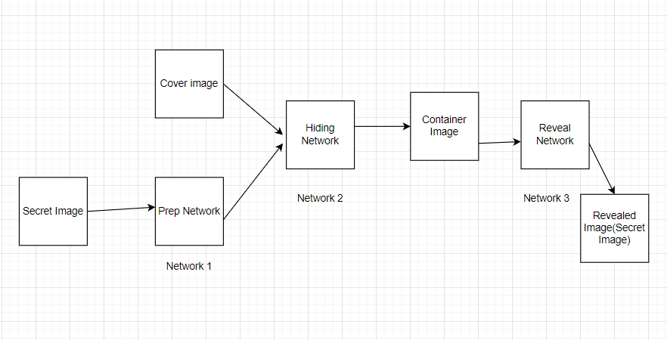
Architecture of the System

Slide 13
References
Subramanian, Nandhini, et al. "Image steganography: A review of the recent advances." IEEE access 9 (2021): 23409-23423.
Kumar, Vijay, Saloni Laddha, and Nitin Dogra Aniket. "Steganography techniques using convolutional neural networks." J. Homepage 7 (2020): 66-73.
Kich, Ismail, Youssef Taouil El Bachir Ameur, and Amine Benhfid. "Image steganography by deep CNN auto-encoder networks." International Journal 9.4 (2020).
Zhang, Tao, et al. "A new JPEG image steganalysis technique combining rich model features and convolutional neural networks." Mathematical Biosciences and Engineering 16.5 (2019): 4069-4081.

Slide 14
Thank You

